Slide 1
Lecture 6: Perception - Color
DS 4200
Fall 2022
Prof. Ab Mosca (they/them)
Northeastern University
Slides and inspiration from Cody Dunne, Dylan Cashman, Remco Chang, Lane Harrison, Connor Gramazio, Michelle Borkin,
Krzysztof Gajos, Hanspeter Pfister, Miriah Meyer, Jonathan Schwabish, and David Sprague

Slide 2
Last Class
We:
Reviewed marks and channels
Reviewed decomposing graphics (ic-04)
Any Questions?

Slide 3
Today
High-level overview of color
Intro to JavaScript

Slide 4
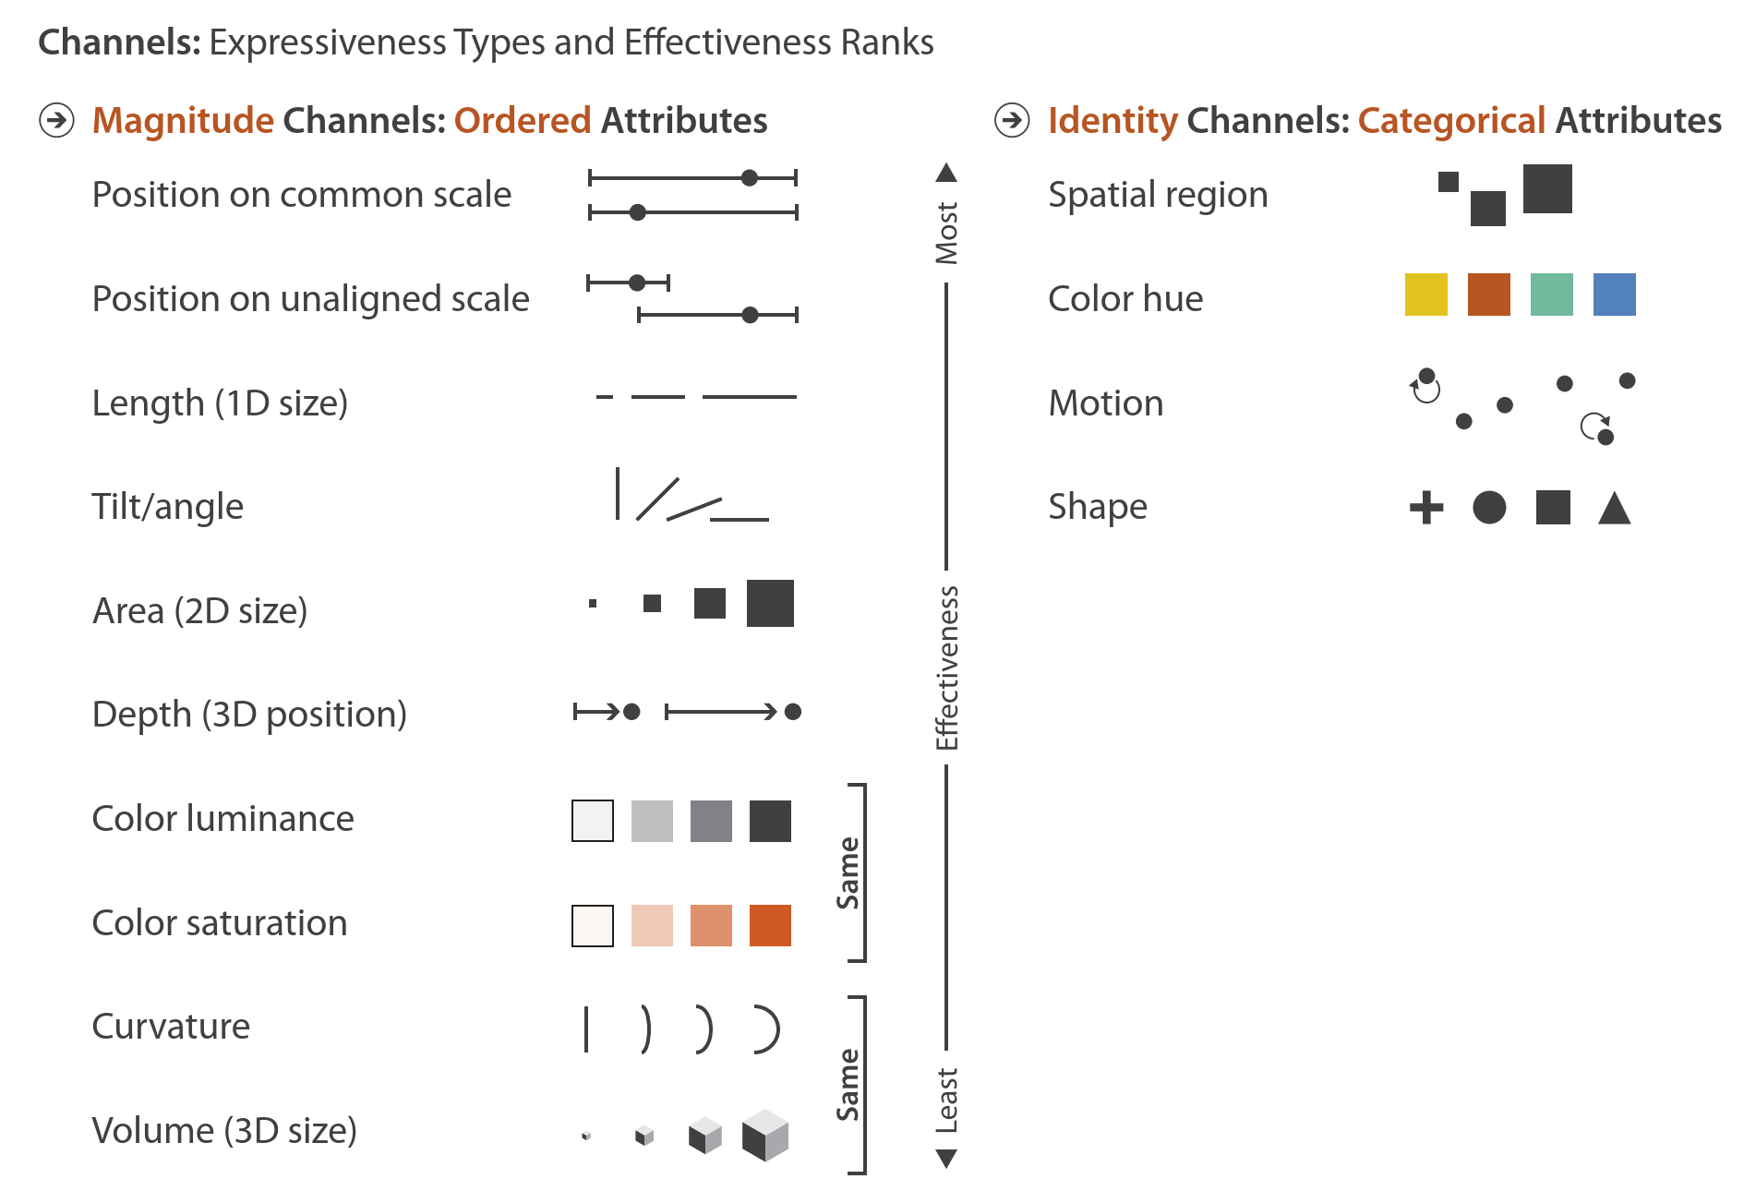

Expressiveness + Effectiveness
Notes:
We talked about ranking different channels based on expressiveness and effectiveness and we talked about how different channels are best suited to different attribute types.
When we discussed how we arrive at these rankings I said they are due largely to the compilation of studies from visualization researchers. A large number of those studies are perceptual studies, or in other words studies that look at how we human perceive these different visual channels.

Slide 5
Color Perception
Notes:
Today, we’re going to talk specifically about the visual channel color, and especially focus on human perception of color.

Slide 6
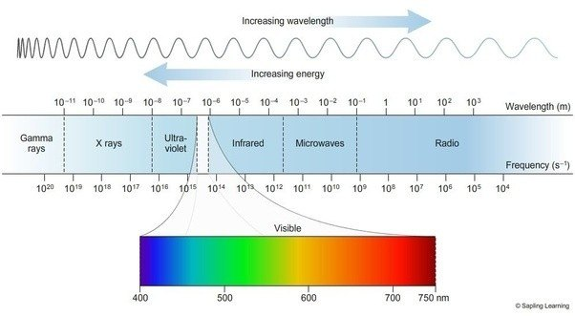
Color results from different wavelengths of light.
Color Perception
Notes:
First off, what is color?
Well, it’s how our brains process the different wavelengths of light that we’re able to see.

Slide 7
Your eye takes in light waves and translates them to lightness/darkness and color.
Color Perception
https://askabiologist.asu.edu/rods-and-cones
Notes:
On a high-level, the way that processing works is like this:
1. Light moves through the lens of the eye to the back of the eye, which is the retina. Here, there are millions of rods and cones.
2. When light hits the retina, the photons it’s made up of activate the rod and cone cells there.
3. The signal from activated rods and cones is sent along until it reaches the inner end of the rods and cones. At this point, the signal is passed to sets of neural cells. 4. Once the signal hits the neural cells, it moves through them in the optic nerve.
5. Ultimately, the optic nerve sends the signal to the brain, where it is further processed so that you see a complete image.

Slide 8

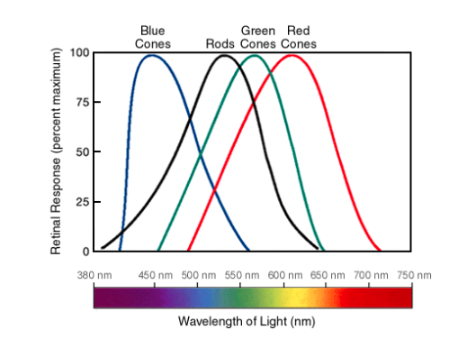
Your eye takes in light waves and translates them to lightness/darkness and color.
Color Perception
Red
Green
Blue
https://askabiologist.asu.edu/rods-and-cones
Notes:
Let’s zero in on rods and cones for a minute.
Rods can be activated in low light, while cones require much brighter light to be activated.
When rods are stimulated, we see white. Because they can be simulated by low light, that’s why we see black and white in dimly lit situations.
There are three different types of cones in our eyes. Each is most sensitive to set of light wavelengths, or color as shown by the graph on the right.
Input from all of your cones in combined to produce color.

Slide 9
Color Perception
This is why lightness/darkness is an effective encoding channel!
Rods:120 million
Cones: 5-6 million
This is why we are so sensitive to red!
Cones:
64% red-sensitive
32% green-sensitive
2% blue-sensitive.
https://askabiologist.asu.edu/rods-and-cones
Notes:
Collectively, you have about 120 million rods and 5-6 million cones in each eye.
This is why lightness/darkness is such an effective encoding channel – because we have so many rods that specialize is processing white light.
In addition to having more rods than cones, note that the distribution of the types of cones in your eyes is not even. You have far more red-sensitive cones than green or blue sensitive cones.
This uneven distribution is directly related to how sensitive our eyes are to each of these color categories.

Slide 10
Color Models and Spaces
Color Model \ Space = Mathematical model describing the way colors can be represented.
https://www.photoreview.com.au/tips/outputting/colour-spaces-explained/#:~:text=Colour%20spaces%20are%20mathematical%20models,%3A%20red%2C%20green%20and%20blue.
Notes:
One approach to representing color on a screen is to describe color as a mix of red, green, and blue light.

Slide 11
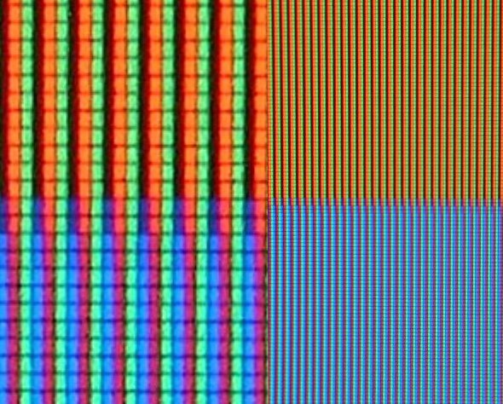
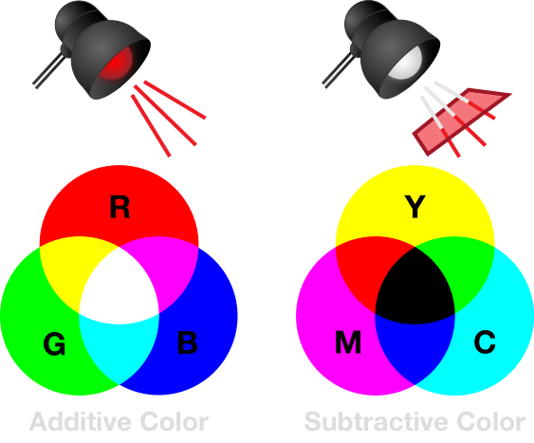


RGB (Red, Green, Blue)
Notes:
One of the most collom color models is the RGB model, which is often used in computer graphics.

Slide 12
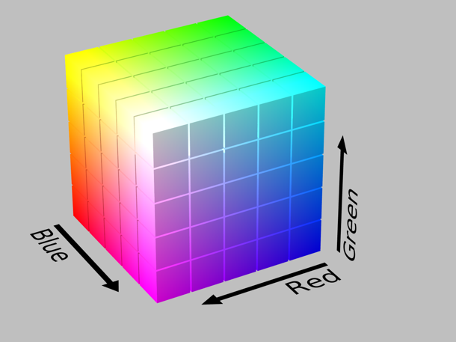
RGB
Colors exist in a cube space and are mixtures of Red, Green, and Blue
Notes:
In this model, each color is represented as a tuple of R, G, and B values.
When we think about showing color in this way, we’re defining each color as a three dimensional point in Red, Green, Blue color space.

Slide 13




RGB
Issues
Distance between colors nowhere near how we perceive differences
A: (5, 7, 15) B: (15, 17, 25)
rgb(0, 128, 0) rgb(10, 138, 10)
rgb(128, 0, 0) rgb(138, 10, 10)
Notes:
While this approach is really convenient for representing color on a computer screen, the down side of this approach is that when we measure differences between colors in this 3d space we get values that are nowhere near how we perceive differences between colors in our brains.
For example, imagine I have two data item I want to represent, A and B. Each item is represented by a tuple. Let’s say I want to represent these values using the visual channel color. Well, depending on the color I choose for A, then corresponding color I get for my end point, B could be mathematically the same distance away, but perceptually a different distance away.
Notice here how the difference between the greens seems a lot more noticeable than the distance between the reds, despite the fact that the RGB values for each are equally spaces.

Slide 14
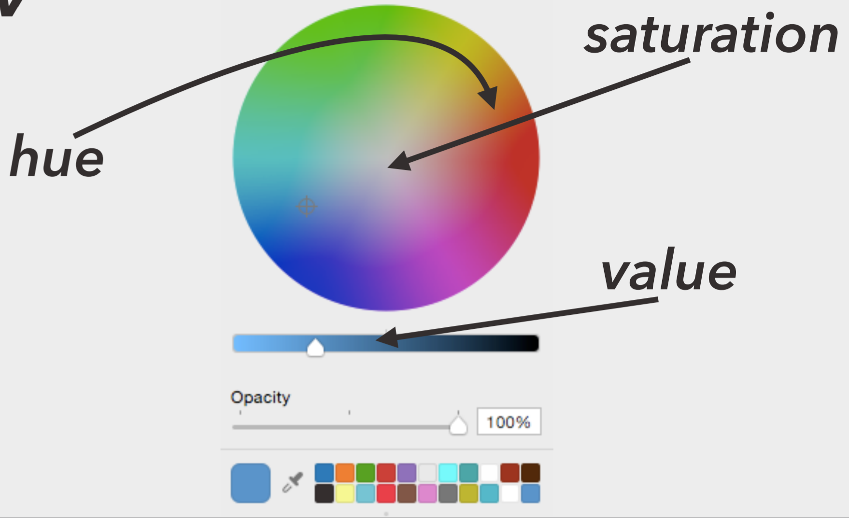
HSV/L (Hue-Saturation-Value/Lightness)
Notes:
Another color model that is often used instead of RGB is the HSV or L model. <next>

Slide 15
HSV/L (Hue-Saturation-Value/Lightness)
Hue = Pure colors (not mixed with white or black)
Saturation = Amount of white mixed with pure color
Value/Lightness = Amount of black mixed with pure color
Notes:
In this model, colors are represented by hue, saturation, and lightness or value. <read to define>

Slide 16


HSV/L (Hue-Saturation-Value/Lightness)
Distance between colors is closer, but not identical to how we perceive differences
A: (5, 7, 15) B: (15, 17, 25)
hsv(120, 100, 50) hsv(130, 110, 60)
hsv(0, 100, 50) hsv(10, 110, 60)
Notes:
With this model, perceptual distance between colors is closer to mathematical distance, but the mapping still isn’t perfect.

Slide 17
Colormaps
Notes:
So, now that we’ve talked about all the things that can go wrong with color you might be wondering how you are ever supposed to choose the correct colors for your visualizations.

Slide 18
Colormaps
Help us choose the correct colors to represent different attribute types
Categorical
Sequential
Divergent

Slide 19
Categorical
Different color = different category
Protip: choose colors that are perceptually distant
Protip: choose colors that are roughly the same saturation and value

Slide 20
Sequential
Saturation indicates difference in the amount of the phenomenon
Protip: people interpret darker as meaning more

Slide 21
Divergent
Two colors used to indicate extremes of a range
Protip: neutral color in the middle
Protip: differentiate between “average” or midpoint and “no data”

Slide 22
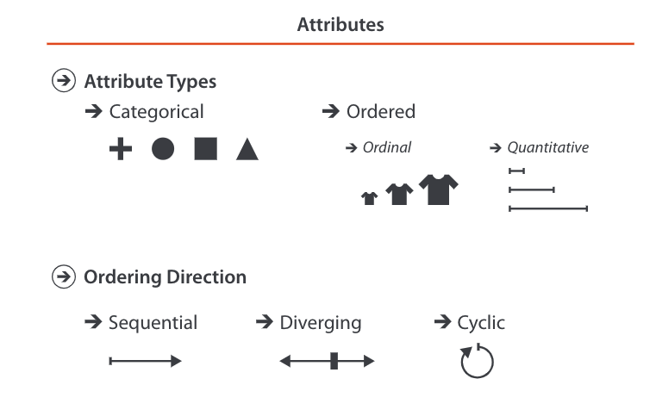
Expressiveness + Effectiveness
Divergent
Sequential
Categorical
Notes:
We talked about ranking different channels based on expressiveness and effectiveness and we talked about how different channels are best suited to different attribute types.
When we discussed how we arrive at these rankings I said they are due largely to the compilation of studies from visualization researchers. A large number of those studies are perceptual studies, or in other words studies that look at how we human perceive these different visual channels.

Slide 23
Picking a Colormap
http://vrl.cs.brown.edu/color
http://colorbrewer2.org/
Notes:
But how do I pick a color map? Well, there are tools available!
Colorbrewer, on the left. Has numerous pallets for different types of data, and its color pallets are integrated into a lot of third party tools such as python, d3, or R.
Colorgorical, on the right, lets you search for color pallets not just based on perceptual differences but also on semantic (or name differences), and how good people typically think colors look together.
I highly recommend using these tools when you’re trying to decide on colormaps for your visualizations.

Slide 24
Color Considerations
Notes:
Now that we understand how color is modeled and the mismatch between how we are able to represent it mathematically versus our perception of it, let’s discuss some important considerations when you’re selecting colors for your visualizations.

Slide 25
Colors - Beware
When possible, use semantically meaningful colors
(ex. red=hot, blue=cold)
Be aware of cultural differences
(ex. red in Chinese Culture vs Red in US culture)
Notes:
When possible, prioritize using semantically meaningful colors, and be aware of cultural differences in the perception of different colors.

Slide 26
Colors - Beware
Use colorblind safe pallets.
Notes:
Beware of whether the color maps you’re using are colorblind safe. You should always strive to be as inclusive as you can when you design your visualizations.

Slide 27
Colors - Beware
Saturation can cause illusions
High Saturation
→ Participants reported more red than green
Low Saturation
→ Participants reported equal proportions (which is correct)
Cleveland & McGill, “A Color-Caused Optical Illusion on a Statistical Graph”, 1983
Notes:
Be aware that there’s an interference between saturation and perception of area for some colors.

Slide 28
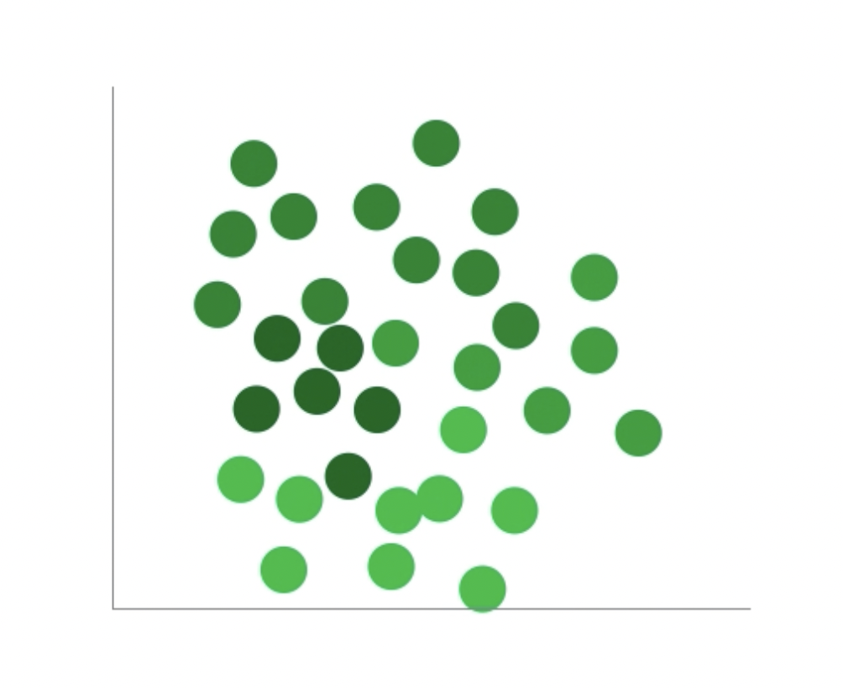
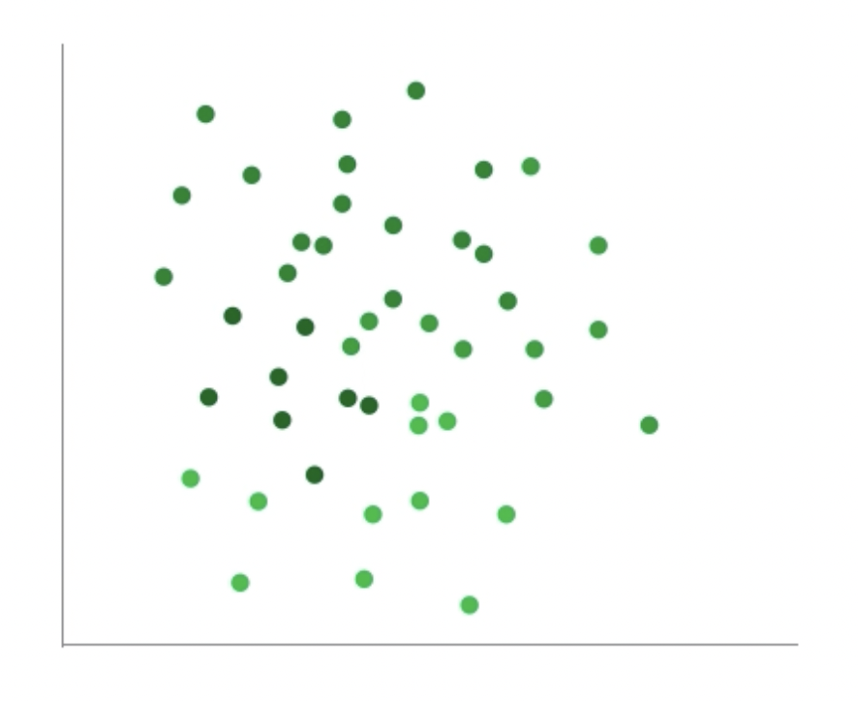
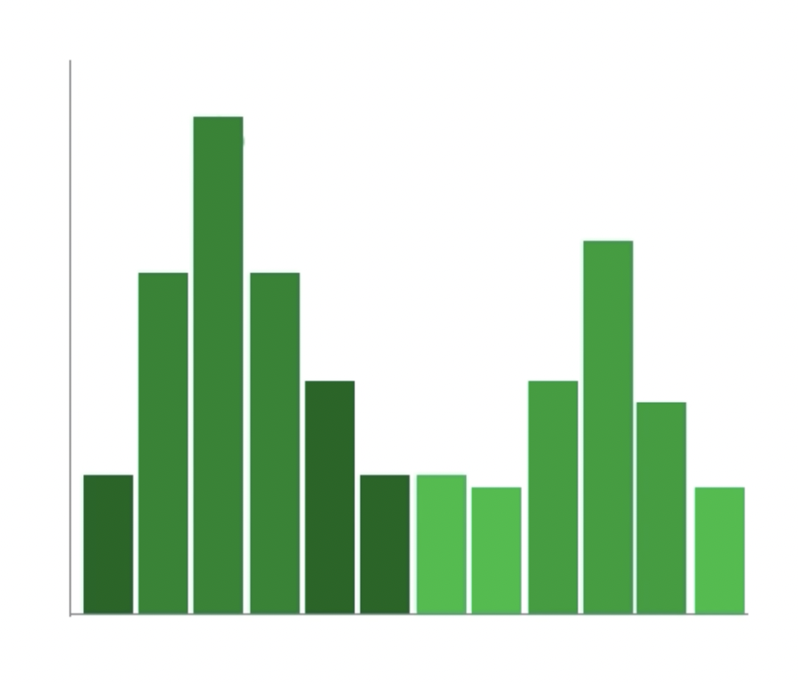
Colors - Beware
Mark type and size effects how we perceive color
How many categories?
Szafir. Modeling Color Differences for Visualization Design
Notes:
Similarly, be aware that there is an interference between size and types of marks you use and how color is perceived.

Slide 29
Colors - Beware
Is the smaller rectangle a solid color or gradient?
Notes:
Beware of simultaneous contrast. For example, who thinks the rectangle on the foreground is a solid color and who thinks is it colored with a gradient?

Slide 30
Colors - Beware
Simultaneous contrast – using a gradient as a background can distort how we see the foreground
→ Avoid using gradients as backgrounds
Notes:
Beware of whether the color maps you’re using are colorblind safe. You should always strive to be as inclusive as you can when you design your visualizations.

Slide 31
Colors - Beware
Are the smaller rectangles the same color or different colors?
Notes:
How about here, are the two rectangles in the foreground the same color or different?

Slide 32
Colors - Beware
Simultaneous contrast – solid backgrounds can distort how we see foreground shapes
Notes:
Beware of whether the color maps you’re using are colorblind safe. You should always strive to be as inclusive as you can when you design your visualizations.

Slide 33
Colors - Beware
Simultaneous contrast – solid backgrounds can distort how we see foreground shapes
Notes:
Beware of whether the color maps you’re using are colorblind safe. You should always strive to be as inclusive as you can when you design your visualizations.

Slide 34
Colors - Beware
Are the smaller rectangles the same color or different colors?
Notes:
Is this also true with colors? Are these greens the same or different?

Slide 35
Colors - Beware
#009C59
#009051
Different!
Notes:
Is this also true with colors? Are these greens the same or different?

Slide 36
Colors - Beware
Are the smaller rectangles the same color or different colors?
Notes:
Is this also true with colors? Are these greens the same or different?

Slide 37
Colors - Beware
Simultaneous contrast – solid backgrounds can distort how we see foreground shapes

Slide 38
Colors - Beware
Simultaneous contrast – solid backgrounds can distort how we see foreground shapes

Slide 39
Colors - Beware
Von Bezold Spreading Effect – borders can change the appearance of shape’s colors
Notes:
Last but not least, beware of the von bezold spreading effect, which means borders can change the appearance of shapes colors. For example here who would say the shapes on the right are darker than those on the left?
This is something to be especially aware of when you’re formatting your legends for charts. If you use a border there but not on your chart people might not think they are looking at the same color.

Slide 40
Let’s take a break! Stretch, go for a walk, be social ☺ Be back here in 10 mins.

Slide 41
JavaScript

Slide 42
ic-05: JavaScript Pt. 1

Slide 43
Summary
Today we:
Reviewed color at a high-level
Practiced JavaScript(ic-05)
hw-03 is OUT today.
ic-05 is DUE today.

